Slide 1
Official mail will become primarily digital in spring 2026
What does the change mean?

Slide 2
What is the Digital First change about?
In line with the Government Programme, Finland will gradually shift to prioritising digital services in official transactions. Legislation will be amended to make digital official communications the primary channel.
Starting from 14 April 2026, when legislation on the digital priority of official mail comes into force, digital service users will receive official mail (e.g. decisions) primarily digitally instead of paper mail.
A person who uses digital services is guided to start using Suomi.fi Messages when they strongly authenticate themselves in an electronic public administration service.

Slide 3
Over 1.5 million new Suomi.fi Messages users
use Suomi.fi e-Identification when accessing public administration e-services
Suomi.fi e-Identification
4,300,000 people
Suomi.fi Messages
2,600,000 people
1,700,000 people
currently receive official mail electronically via Suomi.fi Messages (March 2025)
will become new users
by 2026

Slide 4
Implementation in 2026
The change applies to
adult users who identify themselves in an authority's e-service.
A person who uses digital services is guided to start using Suomi.fi Messages when they strongly authenticate themselves in an electronic public administration service.
The change does not apply to
persons who already use electronic messages
persons who do not use digital services
persons under guardianship or
with a valid continuing power of attorney
minors
companies.
They can return to paper mail by notification through the Suomi.fi Messages settings or the Suomi.fi customer service.

Slide 5
Implementation in phases
12 May 2025 – 13 April 2026
From 14 April 2026
Prompt to enable Suomi.fi Messages
Suomi.fi Messages is activated
Users are prompted to activate Suomi.fi Messages when they identify themselves in an authority's e-service.
It is their choice to activate the service. Suomi.fi Messages is not automatically enabled, and the activation can be skipped.
They must provide an email address and verify it to use Suomi.fi Messages.
They can always opt out and receive messages by paper mail.
People start using Suomi.fi Messages when they authenticate themselves. The activation cannot be skipped.
In connection with the activation, they can
provide an email address to which Suomi.fi Messages sends notifications of received messages.
They can go back to receiving paper mail by notification. They will be prompted to activate Suomi.fi Messages again in 365 days' time when they identify themselves in an authority’s
e-service.
Both stages only apply to adult users of the services.

Slide 6
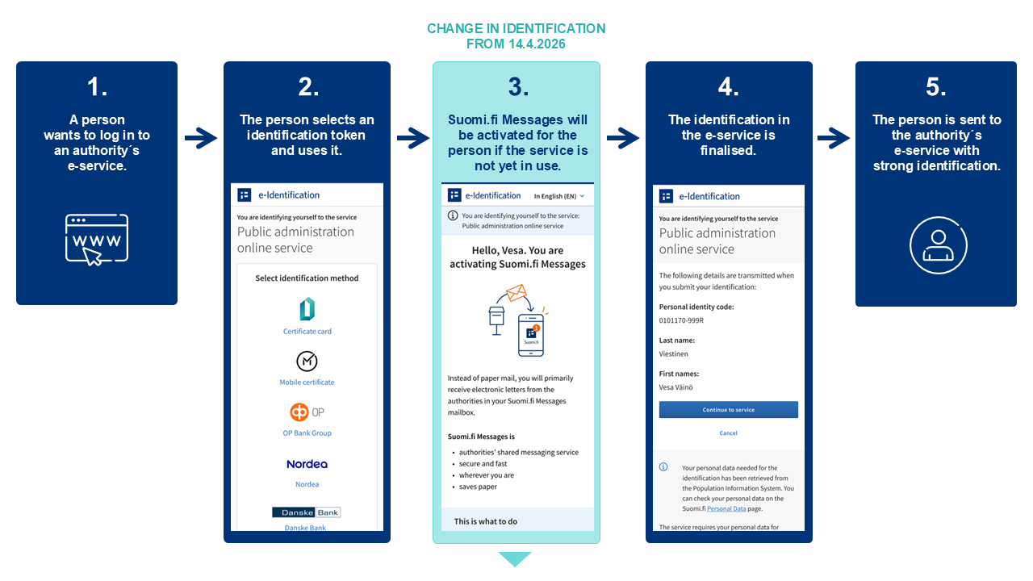

Slide 7
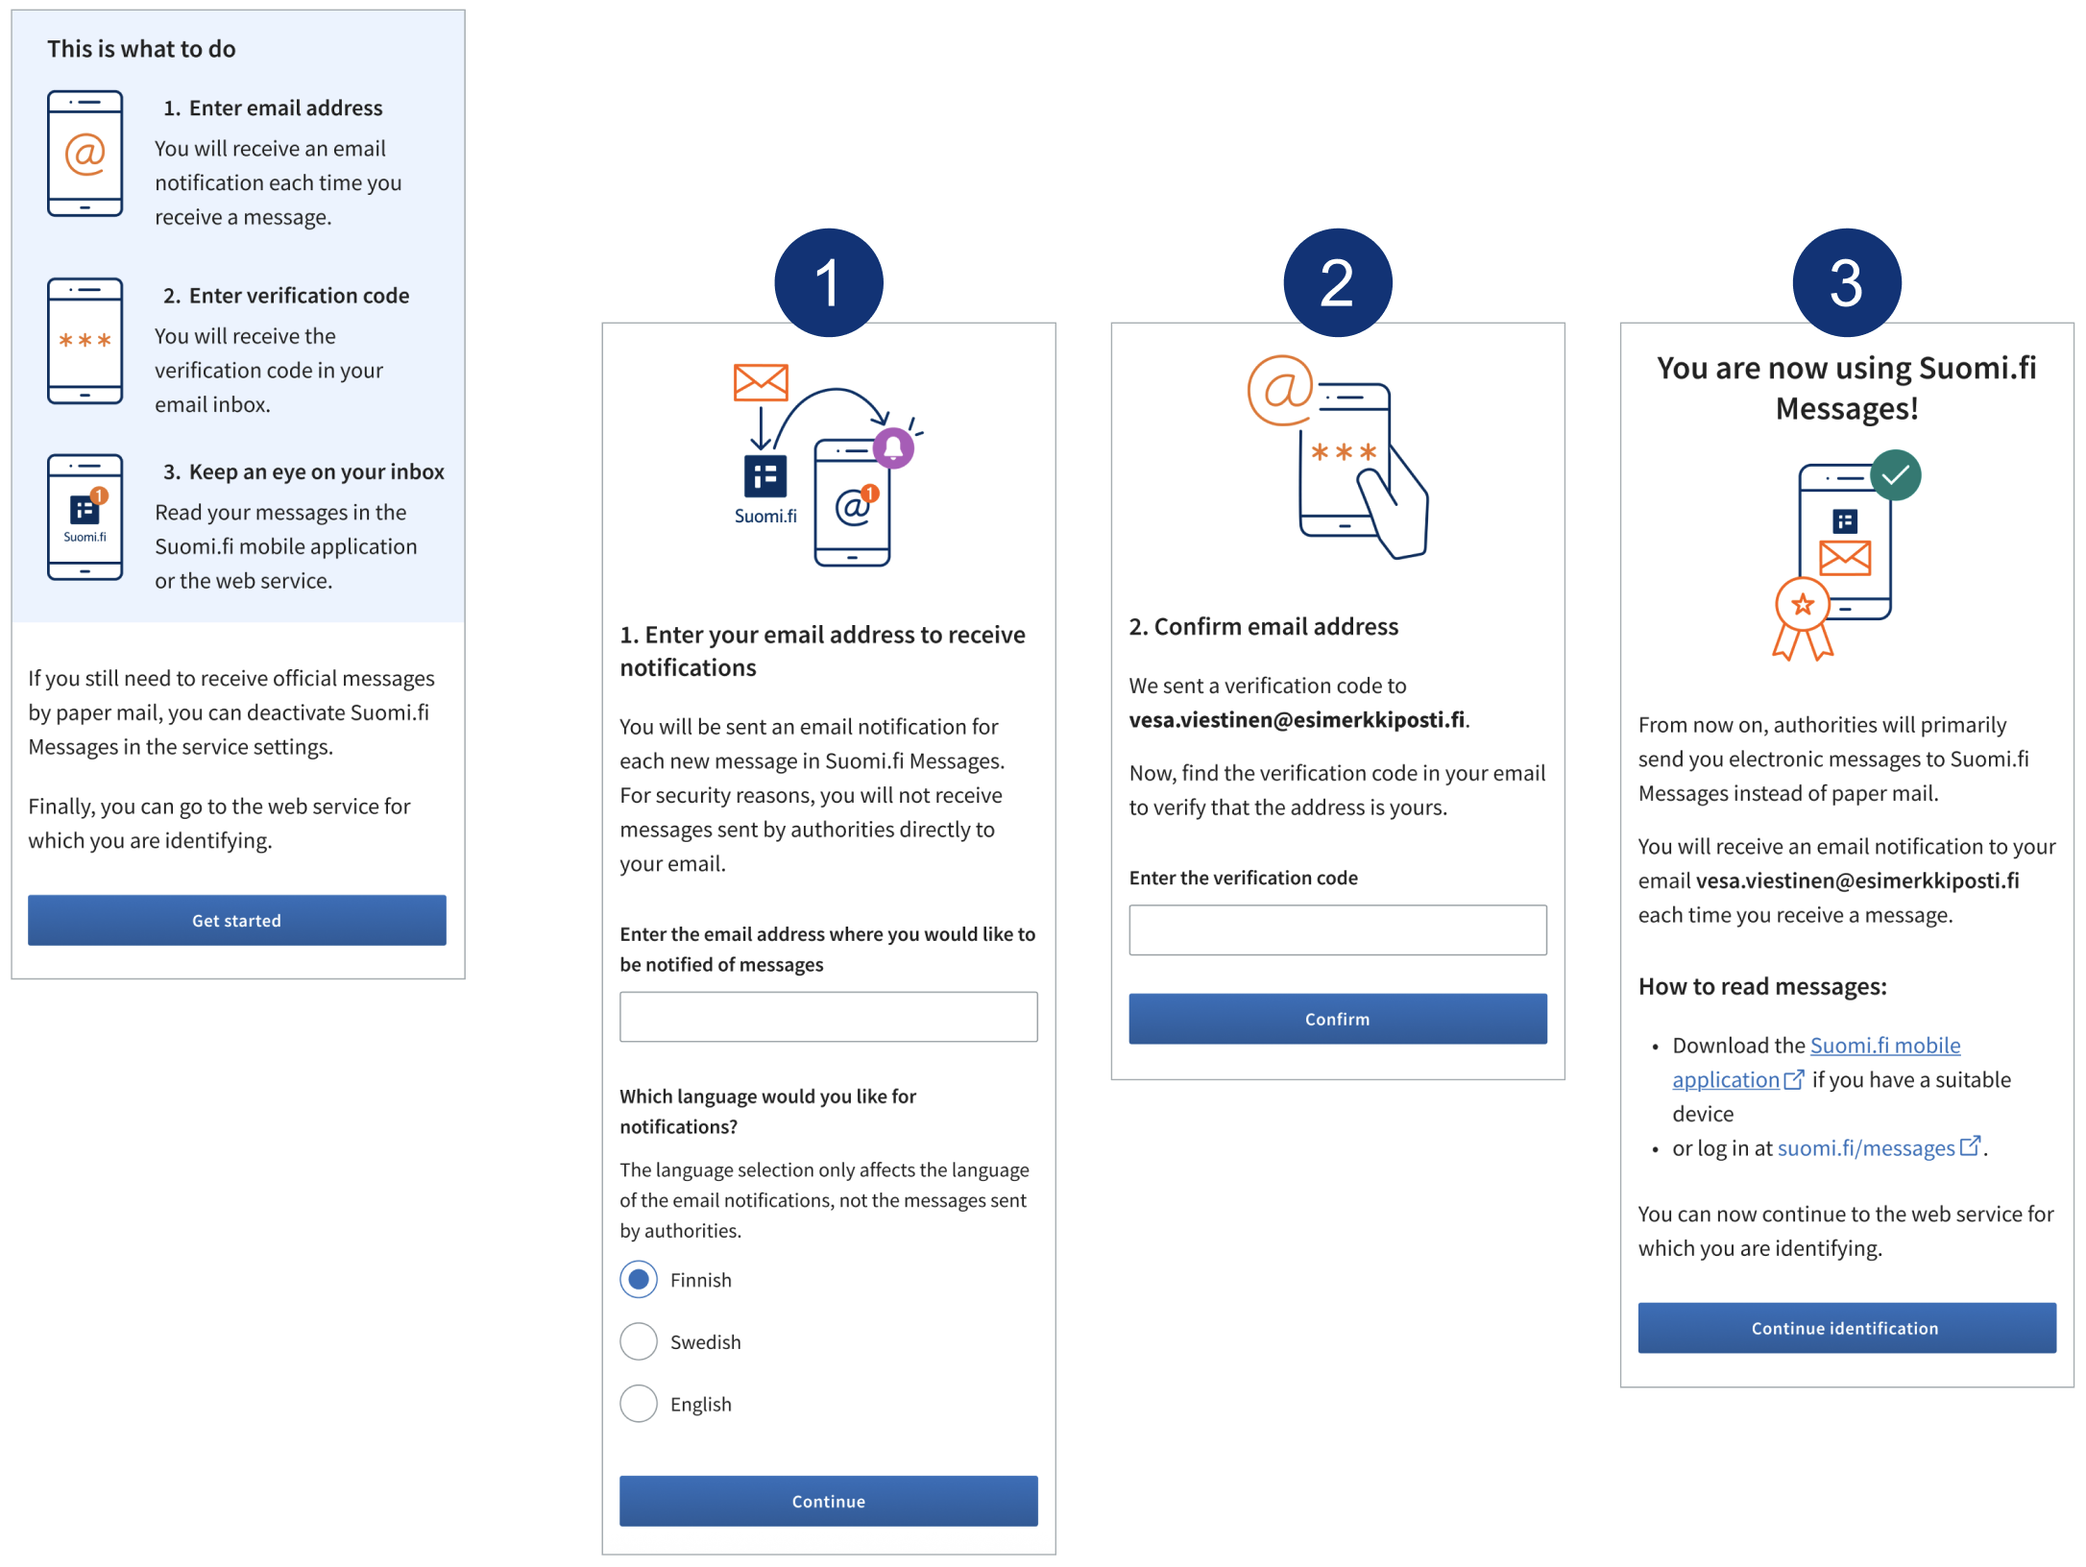
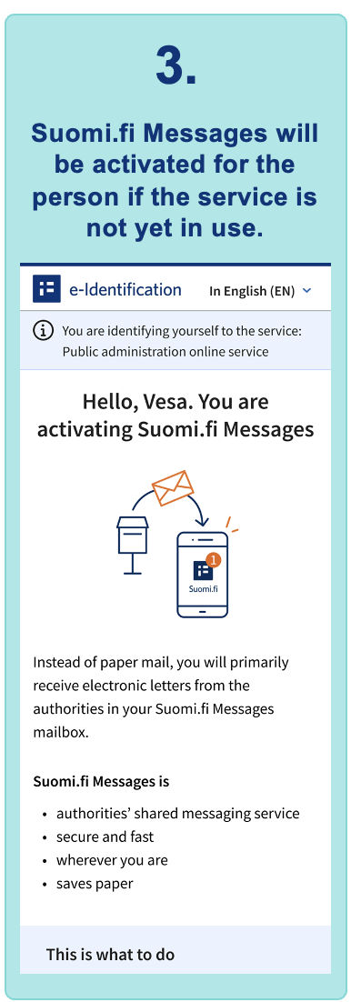
How Suomi.fi Messages is activated when identifying in an authority's e-service.
CHANGE IN IDENTIFICATION
IN THE BEGINNING OF 2026
Notes:
How Suomi.fi Messages is activated when identifying in an authority's e-service from 1 January 2026

Slide 8
Communicate the change to you clients

Slide 9
Informing about electronic communications is important
Decisions, notifications, requests for clarification, invoices and other messages sent by public administration organisations are important for clients and can have major impacts on their life.
It is NOT essential whether your organisation sends messages via Suomi.fi Messages.
Your clients will encounter the change when they identify themselves in your e-service that uses Suomi.fi e-Identification.
It is very important to inform your organisation's clients that future official mail will arrive electronically.
Appoint-
ment
Appointment may go unnoticed
(e.g. surgery, meeting)
Invoice
Invoice may go unnoticed and unpaid.
Client may end up in debt recovery.
Vehicle may be banned from traffic.
Information request
Missed deadline may affect the content of the decision, which can have a direct impact on the person's finances.
Decision
Appeal period may expire, and the person cannot appeal/request a review for the decision.

Slide 10


Communication needs all of us
We need every organisation to take part in the communication so that citizens understand what the change is about.
Please remember to talk about the transition to electronic communications in all your service channels
in-person visits
chat channels
telephone service
e-mail services
e-services
other customer service channels.
Make use of the ready-made communication material:
dvv.fi/en/digital-first-project/organisations/communication-materials

Slide 11
Where can I get support and information?
Citizens
If the question concerns an ongoing service, support is offered by the authority concerned.
If the question concerns the Digital First change or the use of Messages, telephone support is offered by Info in Suomi.fi services on Mon–Fri from 9:00 to 15:00, tel. +358 295 000.
Many providers of general digital support can also answer the most common questions about Suomi.fi Messages.
Instructions for using Suomi.fi Messages: https://suomi.fi/en/messages
Digital support providers and customer service
More information on using Suomi.fi Messages: https://suomi.fi/en/messages
Read more about events and materials for digital support providers: https://dvv.fi/digituen-tapahtumat

Slide 12
The Digital First change will continue

Slide 13
Phases of the Digital First reform from the perspective of the sending organisation
12.5.2025 – 13.4.2026
From 14 April 2026
Late 2026
PHASE 1
Prompt to activate Suomi.fi Messages (12 May 2025 – 13 April 2026)
Users are prompted to activate Suomi.fi Messages when using strong identification in a public administration e-service.
The prompt can be skipped.
Suomi.fi Messages currently has more than 2.6 million users, while around 4.3 million use public administration services electronically.
PHASE 2
Official communications become primarily digital
(Act enters into force on 14 April 2026):
A digital mailbox in Suomi.fi Messages is created when a person identifies themselves in a public administration e-service (e.g. a municipality, wellbeing services county or central government e-service).
Users may not refuse the mailbox creation, but they can return to paper mail.
The change applies only to adult service users who have a Finnish identification token.
A mailbox will not be created for those who do not have identification tokens, do not use services requiring strong identification, are minors or under guardianship.
It is important to visit the digital mailbox and follow incoming mail.
PHASE 3
Option to choose a digital mail service (in late 2026):
In addition to Suomi.fi, a person can select a private digital mail service that meets the information security and other requirements set for official communications.
The freedom of choice requires legislation and technical development, which are only just beginning.
What does this mean for the sending organisation?
It is a good idea to expand the use of Suomi.fi Messages and to switch to the REST interface.
Old connection types will be discontinued at the end of 2026.
Suomi.fi Messages will provide even broader and more comprehensive coverage, as the number of users is constantly increasing and expected to surpass 4 million in 2026.
What does this mean for the sending organisation?
Changes to senders will be minimised.
DVV will provide more detailed information as plans are specified and legislative drafting progresses.
Notes:
Bar removed from the bottom:
The obligation to use Suomi.fi Messages remains, direct connections to other services are not legal.

Slide 14
What should be done now?
Promote the activation and use of Suomi.fi Messages
The obligation to use Suomi.fi Messages remains unchanged, and with the prioritisation, it can help you reach more than four million citizens. You should also start using the Suomi.fi Messages REST interface, which is constantly developed to meet the changes required by the introduction of private operators. All organisations using Suomi.fi Messages must switch to the REST interface by 1 January 2027.
Separate connections to private digital mail services should not be made
Authorities will continue to communicate through a centralised background service administered by DVV, and this service will be used for the integration with private services. Legislation does not and will not allow organisations subject to the use obligation to use private operators for official notifications unless they have applied for exemption.
Organisations will continue to have an obligation to use Suomi.fi Messages.
Notes:
Slide has room for a third possible perspective.

Slide 15
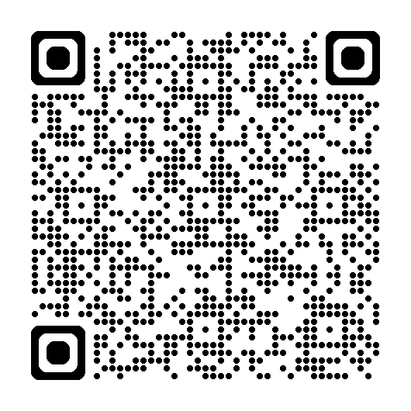
Track the progress
Participate
Follow
Project presentations
Suomi.fi Messages info events
Cooperation in development, communication and organising digital support
Newsletters, press releases
Project pages and materials
Social media: @dvvfi, #DigiEnsin
Register for distribution lists
response.questback.com/dvv/digiensin-jakelulistat

